Slide 1
Using the Contextual Learning Portal
Creating Lesson Plans for the 2020 Teacher Externship Program
http://resources21.org

Slide 2
Technical Assistance
For assistance with any of the screens:
Jennifer Leonard
The Skills Library
Email: jleonard@skillslibrary.com

Slide 3
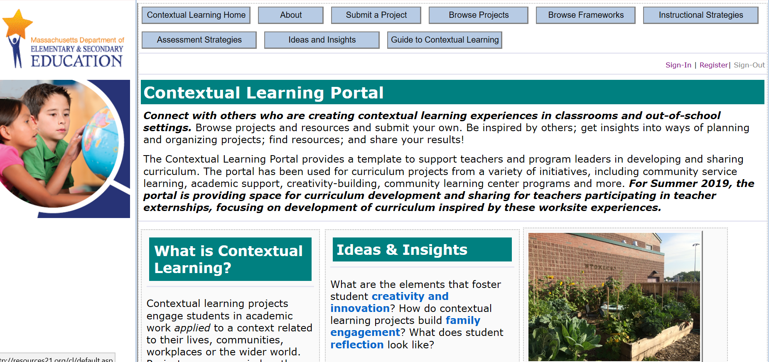
From any page in the Contextual Learning Portal, use the links in the top right to “Register” on your first visit, and to “Sign In” on subsequent visits.

Slide 4
Once you are signed in, click “Submit a Project” on the navigation bar along the top.
On the project page, you will see that you can click to start a “New Project.”
You will also be able to click to continue working on your project once you have started.

Slide 5
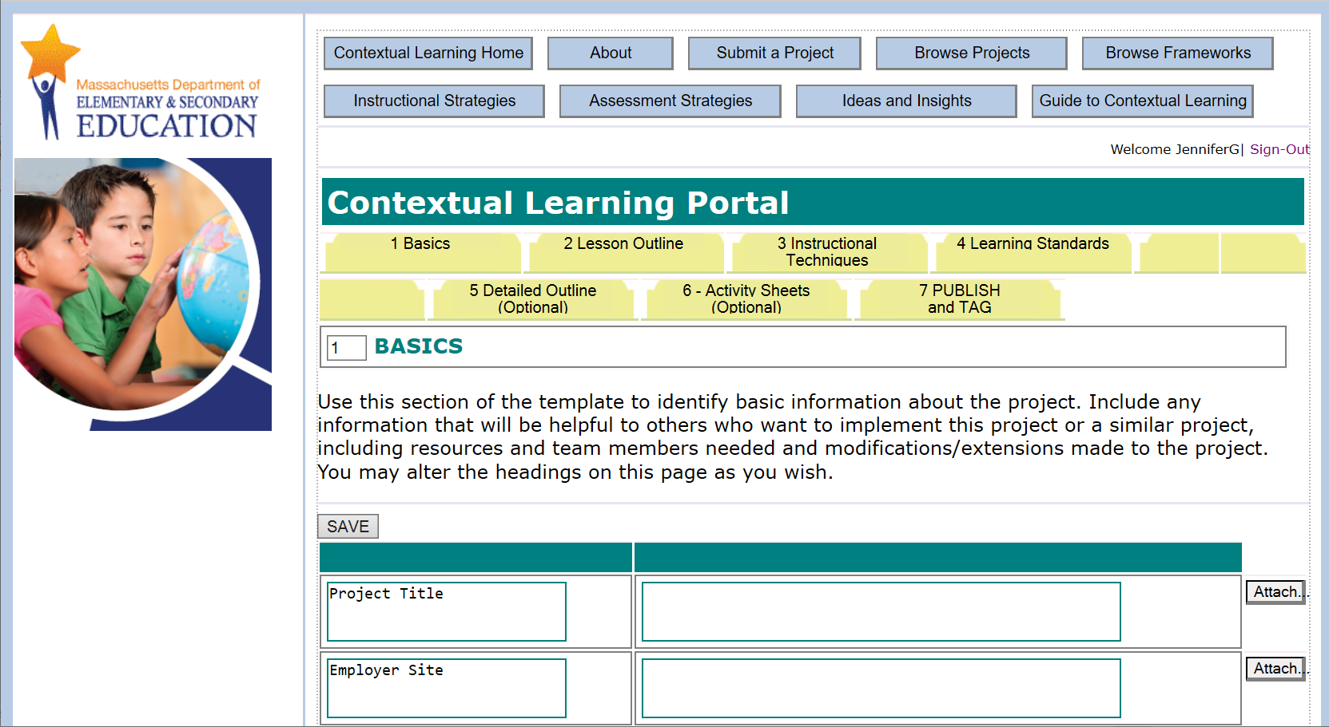
This shows the project template. The template is organized in a series of tabs, starting with 1 – Basics.

Slide 6
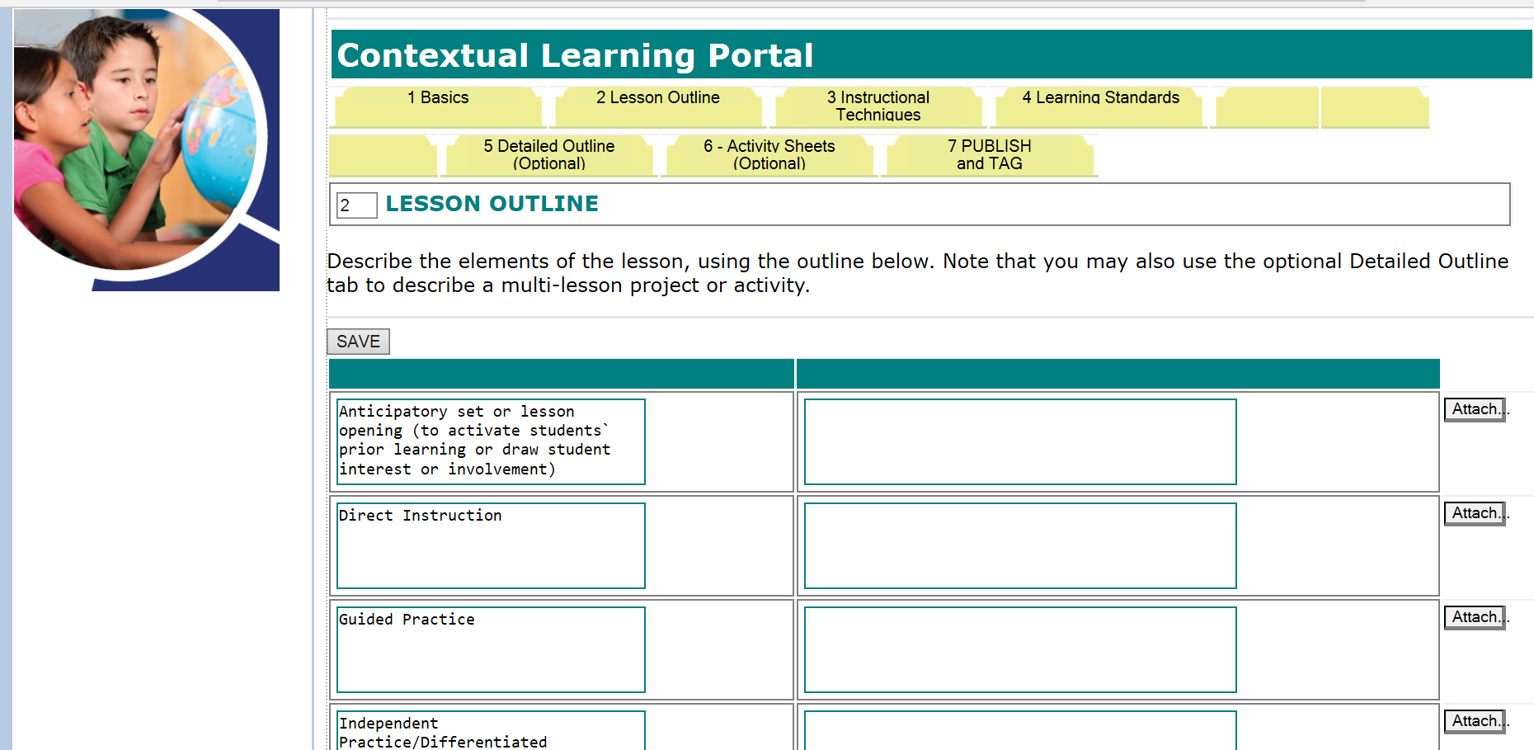
Tab 2 includes the elements of a lesson.

Slide 7
Tab 3 provides space for describing the “Instructional Techniques / Recommended Strategies” that are used in your lesson. Fill in the relevant sections. Notice that on this and every tab in the template, you can attach / upload photos, documents, PowerPoints, or PDFs, or links to websites or other materials.

Slide 8
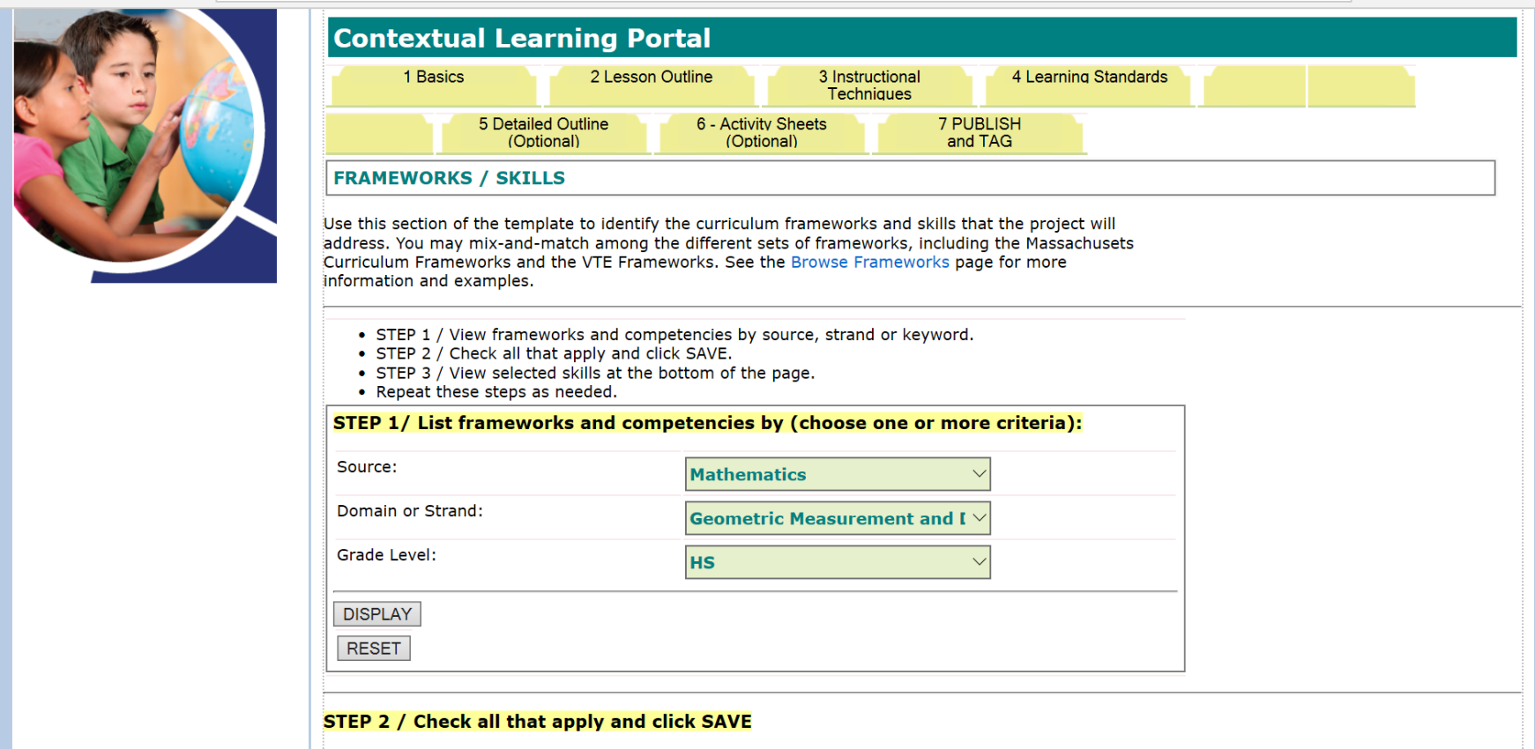
Tab 4 provides checklists for identifying the learning standards used in your lesson. STEP 1: Choose the Framework, then a domain or strand, then a grade level if applicable. The click to DISPLAY. STEP 2: Then check the standards that are relevant to your lesson and click to SAVE.

Slide 9
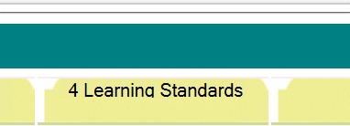
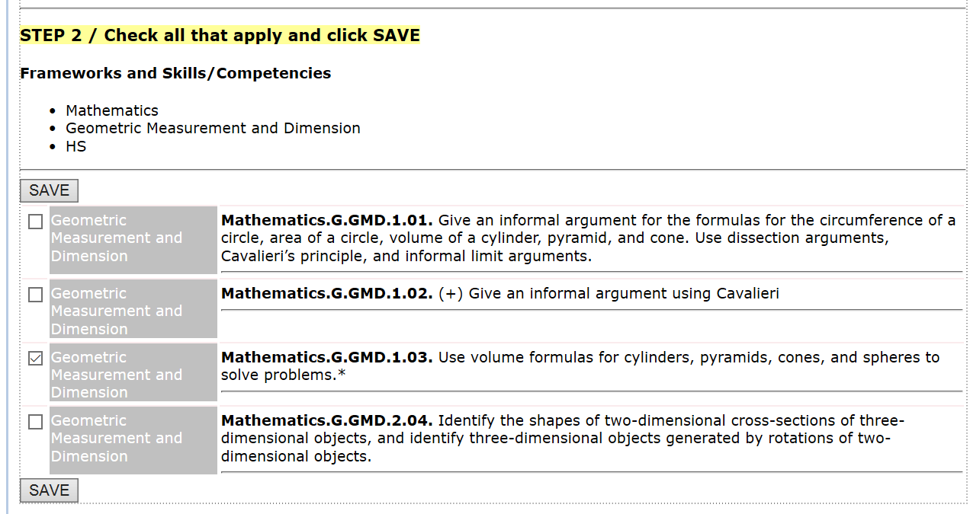
Here is a look at Step 2 of the Learning Standards Tab (Tab 4). Simply check the relevant standards and SAVE…
Repeat to add more from other frameworks.

Slide 10
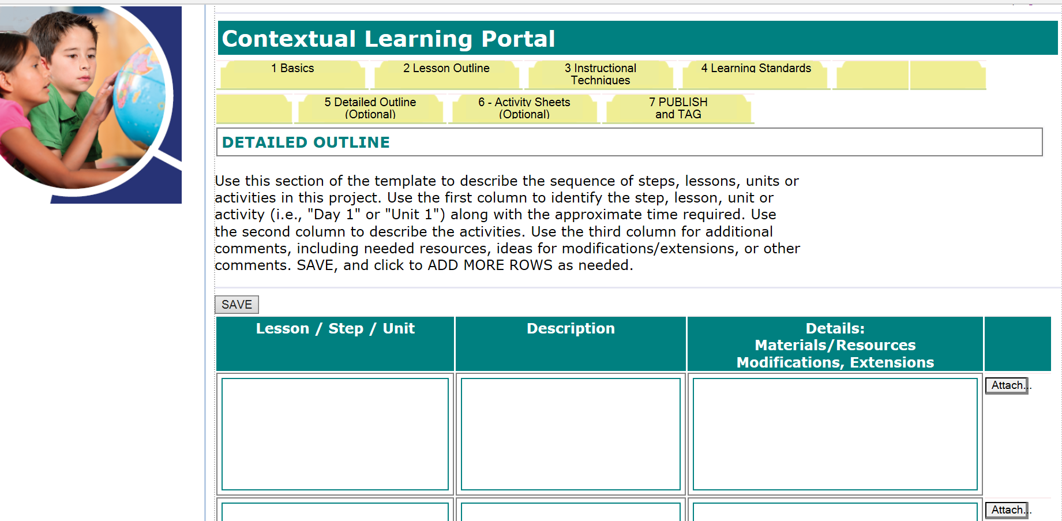
These next two tabs are optional.
Tab 5 provides a flexible grid for creating a multi-lesson outline.

Slide 11
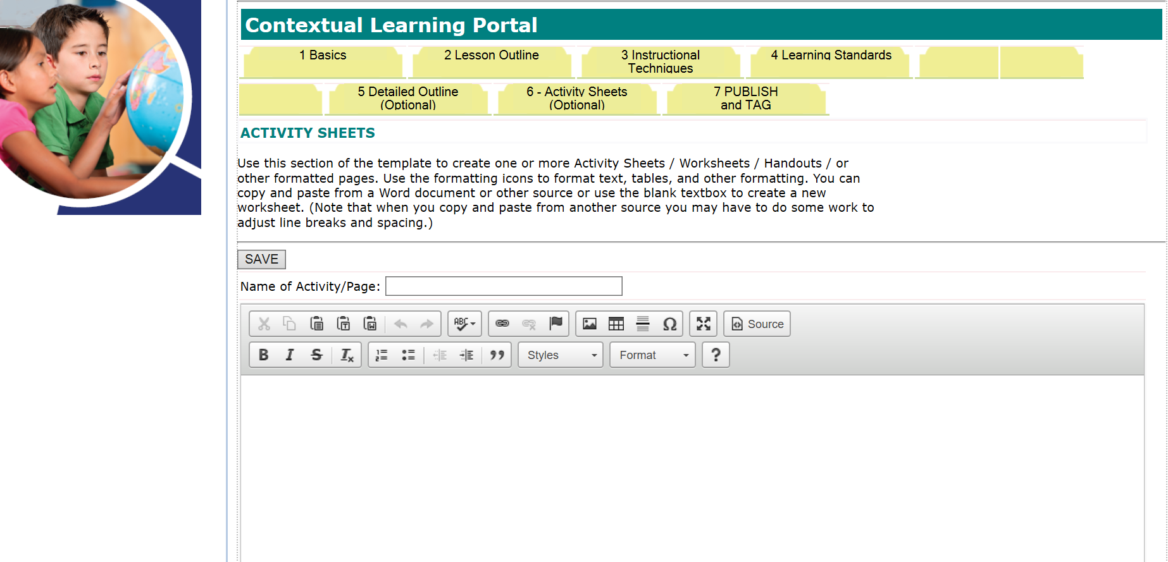
Tab 6 provides a text area for creating “Activity Sheets” which will be displayed online with your lesson plan. You can create and display worksheets, handouts, vocabulary lists, rubrics or other documents using this screen.

Slide 12
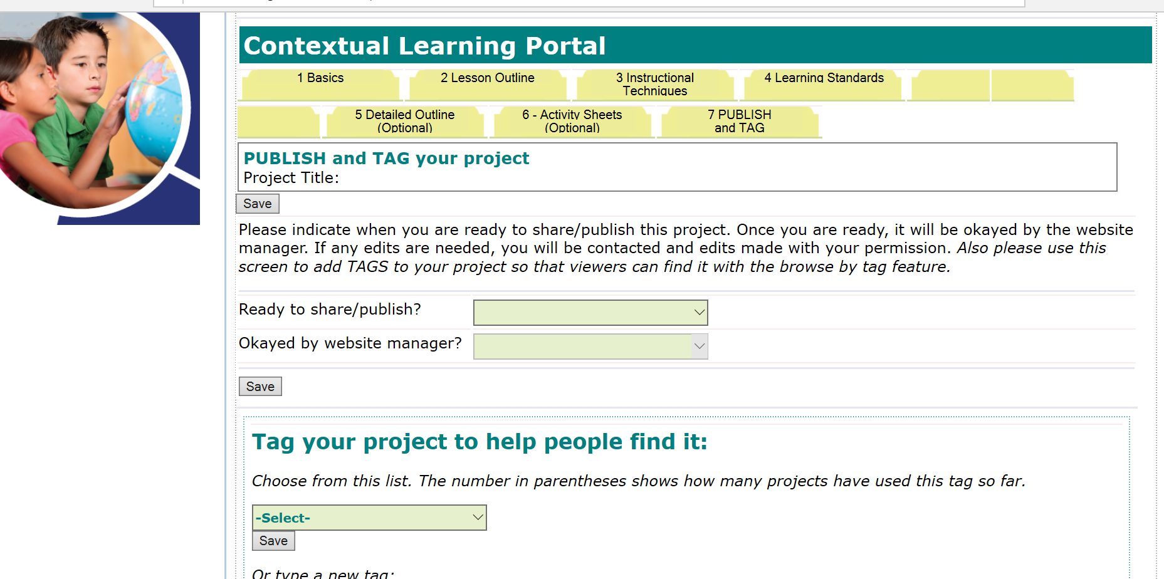
Tab 7 is required for PUBLISHING your project. When you are ready for the project to appear online, fill in YES for the “Ready to Share / Publish” question and click to SAVE. This step will generate an email to the website manager who will okay the project.
Notice that you can choose TAGS to help readers find your project.

Slide 13
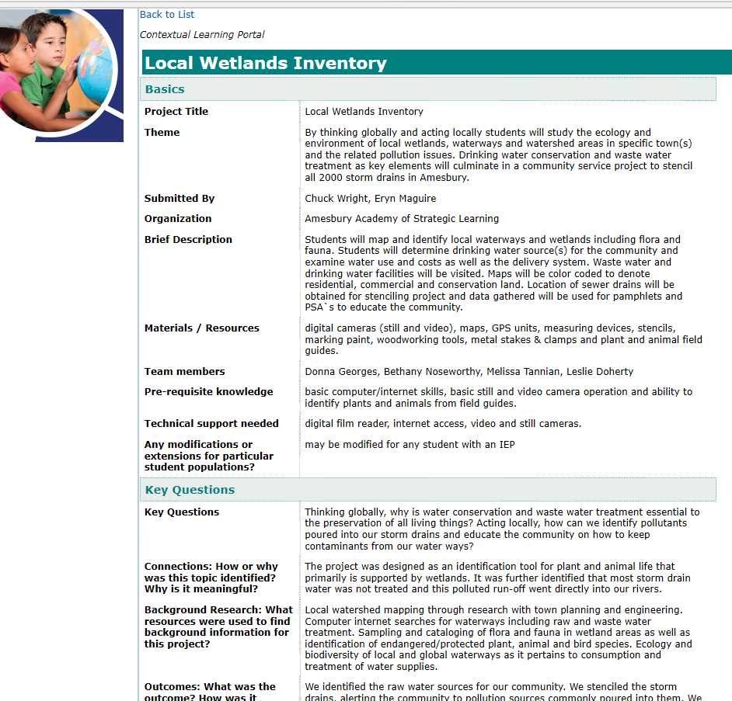
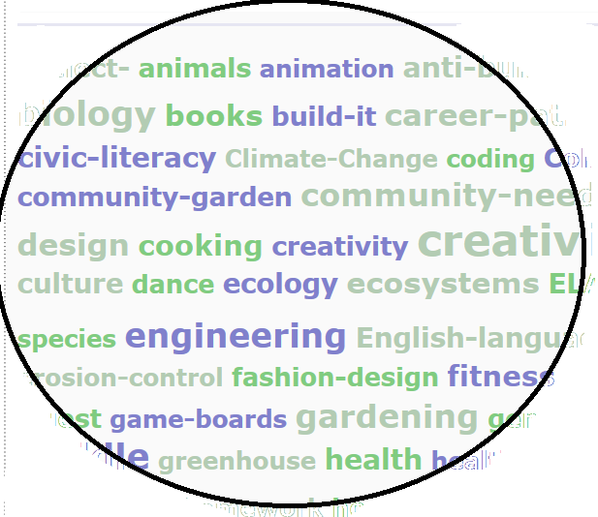
Once published, the project can be viewed on the portal. Readers can search the portal by subject, tags, keywords, framework standards/competencies or other search features to find projects that they can adapt for their own classrooms.

