Slide 1
Hacking the Hacker
Blackstone Valley Tech Info Tech https://bit.ly/2Xragpy

Slide 2
Who am I?
Ms. Cunningham
Information Technology and Networking Instructor
Cyber Security, Ethical Hacking, AP Computer Science, Programming & Web Development, Cisco Networking, CompTIA A+
Coach Soccer and Lacrosse
Game Development Club Advisor

Slide 3
What we will Cover
Types of Hackers
Types of Threats
What/ who do they Target
What are vulnerabilities they look for
How to protect yourself
Password protection
Importance of Digital footprint
Bottomless Pit….never ending!

Slide 5
Types of Hackers
Black Hat: A skilled hacker who uses skills and knowledge for illegal or malicious purposes.
White Hat: A skilled hacker who uses skills and knowledge for defensive purposes only. Interacts only with systems that they have been given permission to access.
Gray Hat: Falls in the middle. May cross the line of what is ethical, but usually has good intentions and isn’t malicious.
ScriptKiddies

Slide 6
Threats Booming in Society
Phishing
Security attacks; spoofing
Ransomware
Social Engineering

Slide 7
Phishing
Phishing is a cybercrime in which a target or targets are contacted by email, telephone or text message by someone posing as a legitimate institution to lure individuals into providing sensitive data such as personally identifiable information, banking and credit card details, and passwords.

Slide 8
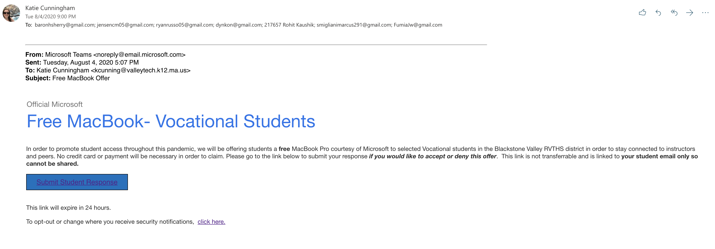

Slide 9
Spoofing
Spoofing is the act of disguising a communication from an unknown source as being from a known, trusted source. Spoofing can apply to emails, phone calls, and websites, or can be more technical, such as a computer spoofing an IP address, Address Resolution Protocol (ARP), or Domain Name System (DNS) server.

Slide 10
Ransomware
A type of malware that threatens to publish the victim's data or perpetually block access to it unless a ransom is paid.

Slide 11
Social Engineering
Everywhere
Be careful what you say/use/ agree to
Not just in IT
Used by con artists alike
Listening

Slide 12
Hacking the Hacker

Slide 13
Digital Footprint
Your digital footprint is all the stuff you leave behind as you use the Internet. Comments on social media, Skype calls, app use and email records- it’s part of your online history and can potentially be seen by other people, or trackd in a database
Websites
Online shopping
Social media
.

Slide 14
Data Protection & Identifying Threats
https://haveibeenpwned.com/
https://howsecureismypassword.net/
Google search
Image search
FirstName Lastname@
FirstName LastName filetype:doc

Slide 15
Challenge 1
Find the hidden flag within. Unzip the folder “The Flag” to begin.
Commands: open, ls, cd

Slide 16
Challenge 2
Find the flag hidden within the file.
Needed: Image

Slide 18
What is Hacking the Hacker?
Educating yourself and others
Knowing where you are
Knowing what you share
Securing Data
Become an ethical hacker on yourself--- break through your own defenses

Slide 19
Questions?
Is Linux a hacking program?

Slide 20
Questions?
Which programming language are most malware written in?

